Slide 1
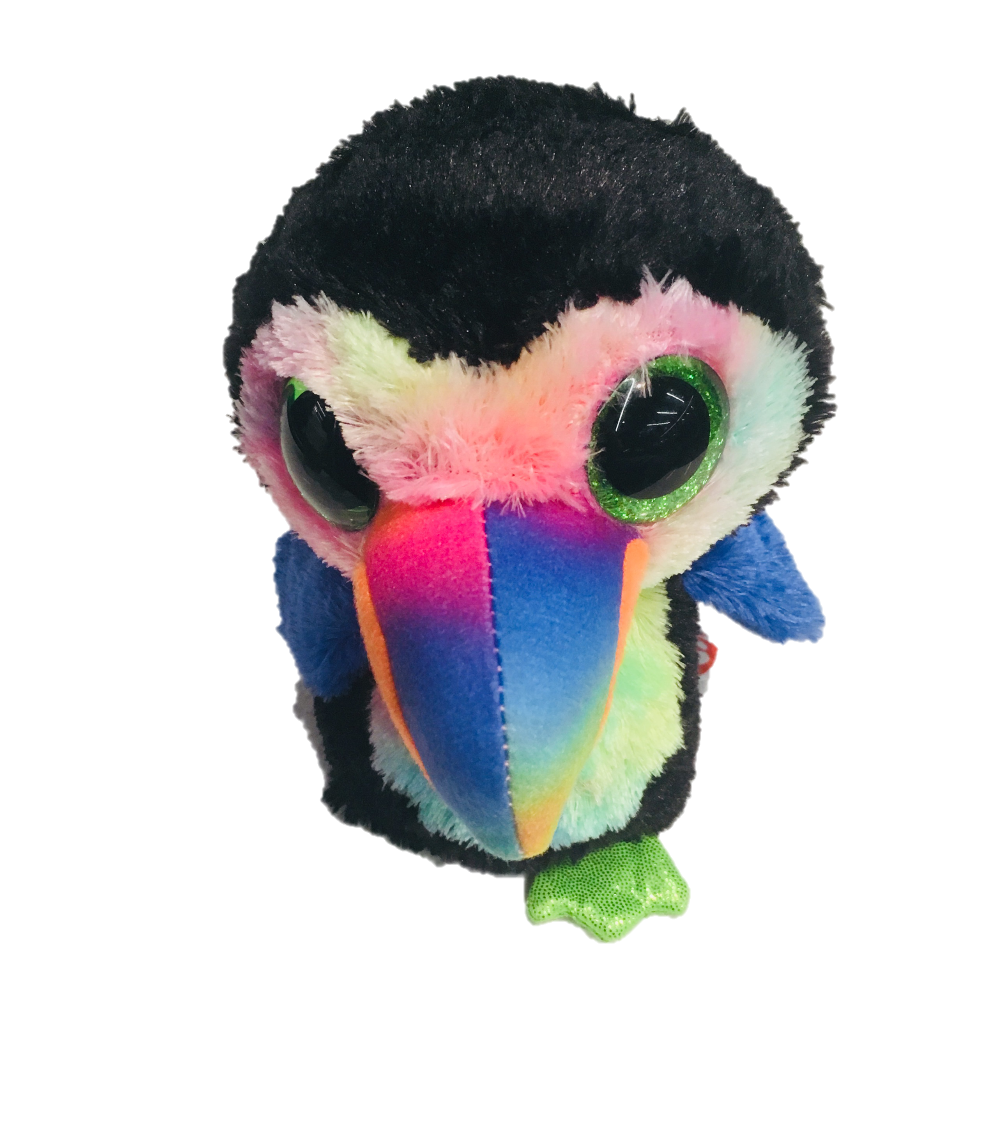
Advanced oTree
Philipp Chapkovski
European University Institute
University of Mainz
June 4-5, 2018
Custom models – Public Good Game

Slide 2
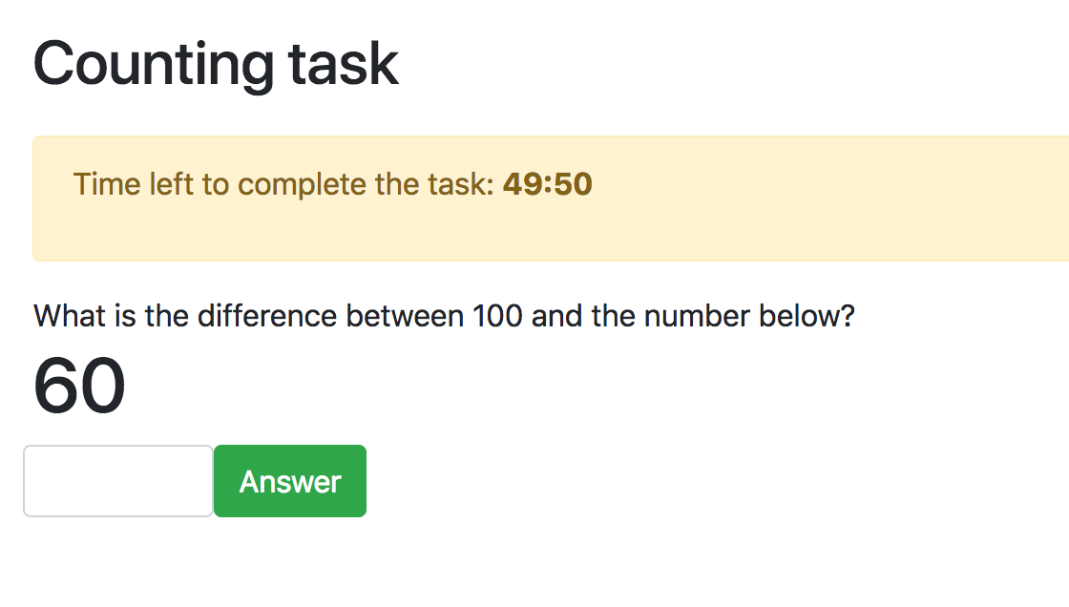
A minimum working version of Django Channels
https://github.com/chapkovski/minimum_ret

Slide 3
Step 1
Create an app minimum with one page (WorkPage)
Set a timer for 60 seconds
Within an app folder create a folder named otree_extensions
Create there an empty file named routing.py
In settings.py type:
EXTENSION_APPS = ['minimum']

Slide 4
Step 2: routing.py
from channels.routing import route_class from channels.generic.websockets import JsonWebsocketConsumer import random
class TaskTracker(JsonWebsocketConsumer): url_pattern = (r'^/tasktracker/$') def connect(self, message, **kwargs): response = random.randint(1, 99) self.send(response) def receive(self, text=None, bytes=None, **kwargs): response = random.randint(1, 99) self.send(response) channel_routing = [ route_class(TaskTracker, path=TaskTracker.url_pattern), ]

Slide 5
Step 2: routing.py
from channels.routing import route_class from channels.generic.websockets import JsonWebsocketConsumer import random
class TaskTracker(JsonWebsocketConsumer): url_pattern = (r'^/tasktracker/$') def connect(self, message, **kwargs): response = random.randint(1, 99) self.send(response) def receive(self, text=None, bytes=None, **kwargs): response = random.randint(1, 99) self.send(response) channel_routing = [ route_class(TaskTracker, path=TaskTracker.url_pattern), ]
Some imports
for randomization
and Django
Channels

Slide 6
Step 2: routing.py
from channels.routing import route_class from channels.generic.websockets import JsonWebsocketConsumer import random
class TaskTracker(JsonWebsocketConsumer): url_pattern = (r'^/tasktracker/$') def connect(self, message, **kwargs): response = random.randint(1, 99) self.send(response) def receive(self, text=None, bytes=None, **kwargs): response = random.randint(1, 99) self.send(response) channel_routing = [ route_class(TaskTracker, path=TaskTracker.url_pattern), ]
That defines the
path that we will
use in our template

Slide 7
Step 2: routing.py
from channels.routing import route_class from channels.generic.websockets import JsonWebsocketConsumer import random
class TaskTracker(JsonWebsocketConsumer): url_pattern = (r'^/tasktracker/$') def connect(self, message, **kwargs): response = random.randint(1, 99) self.send(response) def receive(self, text=None, bytes=None, **kwargs): response = random.randint(1, 99) self.send(response) channel_routing = [ route_class(TaskTracker, path=TaskTracker.url_pattern), ]
What channel
will do when
someone connects

Slide 8
Step 2: routing.py
from channels.routing import route_class from channels.generic.websockets import JsonWebsocketConsumer import random
class TaskTracker(JsonWebsocketConsumer): url_pattern = (r'^/tasktracker/$') def connect(self, message, **kwargs): response = random.randint(1, 99) self.send(response) def receive(self, text=None, bytes=None, **kwargs): response = random.randint(1, 99) self.send(response) channel_routing = [ route_class(TaskTracker, path=TaskTracker.url_pattern), ]
What we do if
message received
from player

Slide 9
Step 2: routing.py
from channels.routing import route_class from channels.generic.websockets import JsonWebsocketConsumer import random
class TaskTracker(JsonWebsocketConsumer): url_pattern = (r'^/tasktracker/$') def connect(self, message, **kwargs): response = random.randint(1, 99) self.send(response) def receive(self, text=None, bytes=None, **kwargs): response = random.randint(1, 99) self.send(response) channel_routing = [ route_class(TaskTracker, path=TaskTracker.url_pattern), ]
helps oTree to
connect our code
with request from
player

Slide 10
Step 3: WorkPage.html
{% block content %} <div>What is the difference between 100 and the number below?</div> <h1 class="question"></h1> <div class="form-row align-items-center"> <input type="number" id="answer" class="form-control"> <button class="answer btn btn-success" type="button">Answer</button> </div> {% endblock %}
Empty div
to show the
number

Slide 11
Step 3: WorkPage.html
{% block content %} <div>What is the difference between 100 and the number below?</div> <h1 class="question"></h1> <div class="form-row align-items-center"> <input type="number" id="answer" class="form-control"> <button class="answer btn btn-success" type="button">Answer</button> </div> {% endblock %}
input
where player
will insert the answer

Slide 12
Step 3: WorkPage.html
{% block content %} <div>What is the difference between 100 and the number below?</div> <h1 class="question"></h1> <div class="form-row align-items-center"> <input type="number" id="answer" class="form-control"> <button class="answer btn btn-success" type="button">Answer</button> </div> {% endblock %}
Button to click
to submit the answer

Slide 13
Step 4: JavaScript
$(function () { var ws_scheme = window.location.protocol == "https:" ? "wss" : "ws"; var ws_path = ws_scheme + '://' + window.location.host + "/tasktracker/"; var socket = new ReconnectingWebSocket(ws_path); socket.onmessage = function (event) { var obj = jQuery.parseJSON(event.data); $('h1.question').html(obj); }; $("button.answer").on("click", function () { var msg = {'answer': $('input#answer').val()}; if (socket.readyState === WebSocket.OPEN) { socket.send(JSON.stringify(msg)); }; $("input#answer").val(''); }); });

Slide 14
Step 4: JavaScript
$(function () { var ws_scheme = window.location.protocol == "https:" ? "wss" : "ws"; var ws_path = ws_scheme + '://' + window.location.host + "/tasktracker/"; var socket = new ReconnectingWebSocket(ws_path); socket.onmessage = function (event) { var obj = jQuery.parseJSON(event.data); $('h1.question').html(obj); }; $("button.answer").on("click", function () { var msg = {'answer': $('input#answer').val()}; if (socket.readyState === WebSocket.OPEN) { socket.send(JSON.stringify(msg)); }; $("input#answer").val(''); }); });
To create a link to
channel

Slide 15
Step 4: JavaScript
$(function () { var ws_scheme = window.location.protocol == "https:" ? "wss" : "ws"; var ws_path = ws_scheme + '://' + window.location.host + "/tasktracker/{{ player.id }}"; var socket = new ReconnectingWebSocket(ws_path); socket.onmessage = function (event) { var obj = jQuery.parseJSON(event.data); $('h1.question').html(obj); }; $("button.answer").on("click", function () { var msg = $('input#answer').val(); if (socket.readyState === WebSocket.OPEN) { socket.send(msg); }; $("input#answer").val(''); }); });
What to do if message
is received

Slide 16
Step 4: JavaScript
$(function () { var ws_scheme = window.location.protocol == "https:" ? "wss" : "ws"; var ws_path = ws_scheme + '://' + window.location.host + "/tasktracker/{{ player.id }}"; var socket = new ReconnectingWebSocket(ws_path); socket.onmessage = function (event) { var obj = jQuery.parseJSON(event.data); $('h1.question').html(obj); }; $("button.answer").on("click", function () { var msg = $('input#answer').val(); if (socket.readyState === WebSocket.OPEN) { socket.send(msg); }; $("input#answer").val(''); }); });
What to do if button
is clicked

Slide 17
Minimum example: something beyound
We want:
to check if the answer is correct
to store number of attempts
to store number of correct answers
to show both on the page
https://github.com/chapkovski/minimum_ret/tree/beyond

Slide 18
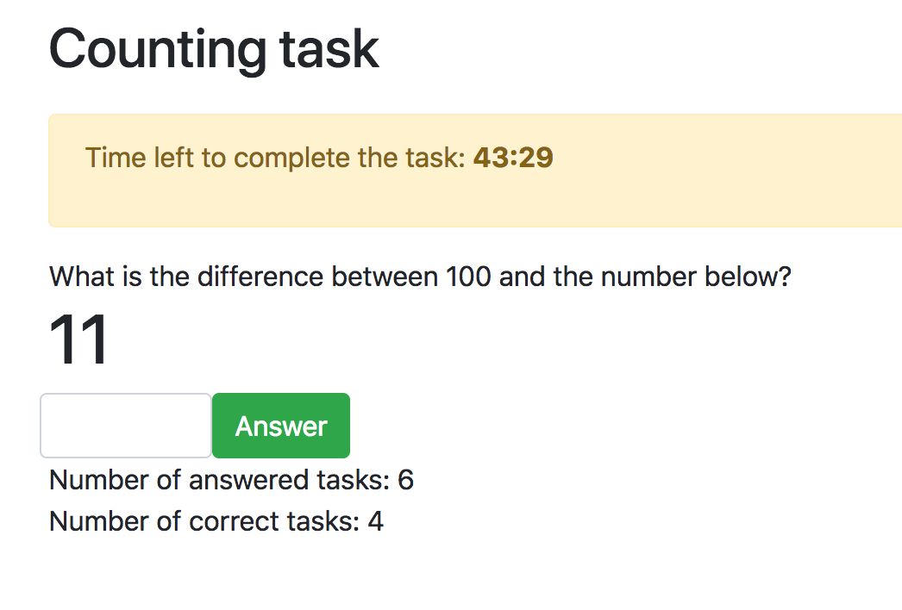
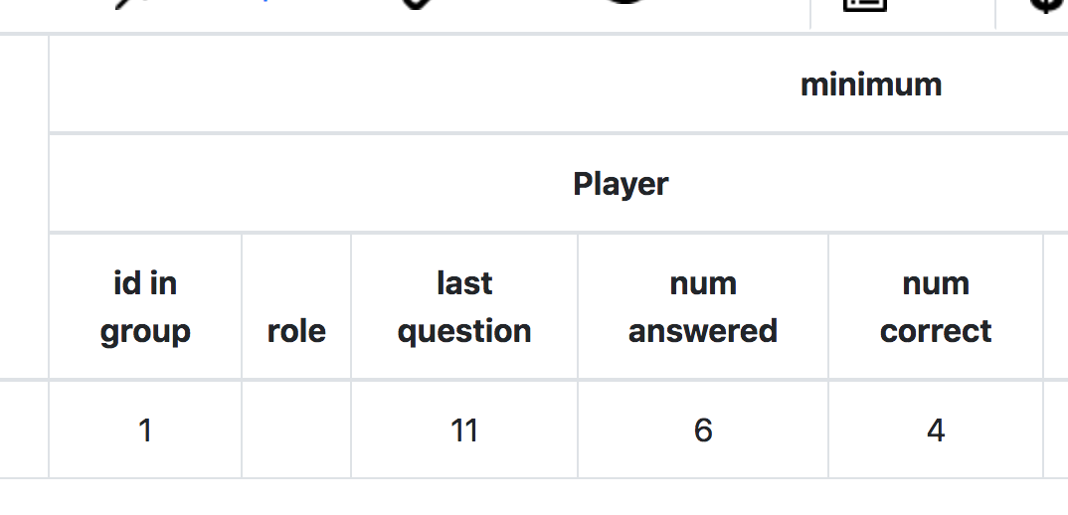
Minimum example: something beyound

Slide 19
Step 5: Models
MODELS:
class Player(BasePlayer): last_question = models.IntegerField() num_answered = models.IntegerField(initial=0) num_correct = models.IntegerField(initial=0)
ROUTING
from minimum.models import Player

Slide 20
Step 6: Updating path
HTML/Javascript:
var ws_path = ws_scheme + '://' + window.location.host + "/tasktracker/{{ player.id }}";
ROUTING
class TaskTracker(JsonWebsocketConsumer): url_pattern = (r'^/tasktracker/(?P<player>[0-9]+)$')

Slide 21
Step 7: Consumers
def connect(self, message, **kwargs): player = Player.objects.get(id=self.kwargs['player']) if not player.last_question: player.last_question = random.randint(1, 99) player.save() response = player.last_question self.send(response)

Slide 22
Step 7: Consumers
def receive(self, text=None, bytes=None, **kwargs): player = Player.objects.get(id=self.kwargs['player']) player.num_answered += 1 if text == 100 - player.last_question: player.num_correct += 1 player.last_question = random.randint(1, 99) player.save() response = player.last_question self.send(response)

Slide 23
Step 8: Showing their progress on the page
HTML
<div>Number of answered tasks:
<span class="num_answered">{{ player.num_answered }}</span></div> <div>Number of correct tasks:
<span class="num_correct">{{ player.num_correct }}</span></div>
JavaScript
socket.onmessage = function (event) { var obj = jQuery.parseJSON(event.data); $('h1.question').html(obj.task); $('span.num_answered').html(obj.num_answered); $('span.num_correct').html(obj.num_correct); };

Slide 24
Step 8: Showing their progress on the page
class TaskTracker(JsonWebsocketConsumer): def prepare_task(self, player): return {'task': player.last_question, 'num_answered': player.num_answered, 'num_correct': player.num_correct, } def connect(self, message, **kwargs): ... response = self.prepare_task(player) self.send(response) def receive(self, text=None, bytes=None, **kwargs): ... response = self.prepare_task(player) self.send(response)

Slide 25
How to prevent submission of a form by enter
$("input#answer").keydown(function (event) { if (event.keyCode == 13) { event.preventDefault(); $("button.answer").click(); return false; } });

Slide 26
Going deeper: storing the history of tasks
We need to store all tasks and the answers
https://github.com/chapkovski/minimum_ret/tree/history

Slide 27
Step 1: models
from django.db import models as djmodels class Player(BasePlayer): dump_tasks = models.LongStringField() num_answered = models.IntegerField(initial=0) num_correct = models.IntegerField(initial=0) class Task(djmodels.Model): player = djmodels.ForeignKey(to=Player, related_name='tasks') question = models.IntegerField() answer = models.IntegerField(null=True)

Slide 28
Step 2: routing.connect
def connect(self, message, **kwargs): player = Player.objects.get(id=self.kwargs['player']) unanswered_tasks = player.tasks.filter(answer__isnull=True) if unanswered_tasks.exists(): task = unanswered_tasks.first() else: task = player.tasks.create(question=random.randint(1, 99)) response = self.prepare_task(player, task) self.send(response)

Slide 29
Step 3: routing.receive
def receive(self, text=None, bytes=None, **kwargs): player = Player.objects.get(id=self.kwargs['player']) oldtask = player.tasks.filter(answer__isnull=True).first() oldtask.answer = text oldtask.save() player.num_answered += 1 if text == 100 - oldtask.question: player.num_correct += 1 newtask = player.tasks.create(question=random.randint(1, 99)) response = self.prepare_task(player, newtask) player.save() self.send(response)

Slide 30
Step 4: routing.prepare_task
def prepare_task(self, player, task): return {'task': task.question, 'num_answered': player.num_answered, 'num_correct': player.num_correct, }

Slide 31
Step 5: WorkPage.before_next_page
class WorkPage(Page): timer_text = 'Time left to complete the task:' timeout_seconds = 10 def before_next_page(self): self.player.dump_tasks = json.dumps(list(self.player.tasks.all().values()))

Slide 32
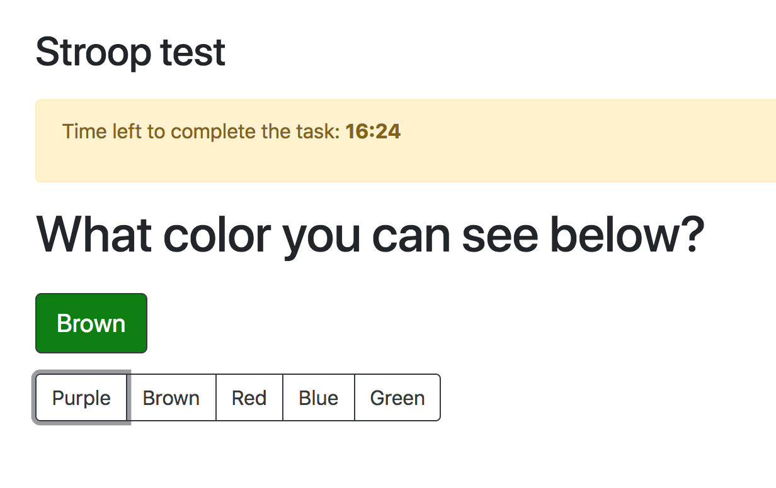
Stroop test
https://github.com/chapkovski/stroop_test

Slide 33
Stroop test: models
class Constants(BaseConstants): name_in_url = 'minimum_ret' players_per_group = None num_rounds = 1 colors = ['Purple', 'Brown', 'Red', 'Blue', 'Green', ] class Subsession(BaseSubsession): ... class Group(BaseGroup): ... class Player(BasePlayer): ...

Slide 34
Stroop test: pages
class WorkPage(Page): timer_text = 'Time left to complete the task:' timeout_seconds = 1000 page_sequence = [ WorkPage, ]

Slide 35
Stroop test: routing
class TaskTracker(JsonWebsocketConsumer): url_pattern = (r'^/tasktracker/(?P<player>[0-9]+)$') def prepare_task(self): color_text, color_color = random.sample(Constants.colors, 2) return {'color_text': color_text, 'color_color': color_color } def connect(self, message, **kwargs): response = self.prepare_task() self.send(response) def receive(self, text=None, bytes=None, **kwargs): print('ANSWER:', text) response = self.prepare_task() self.send(response)

Slide 36
Stroop test: html
<h1>What color you can see below?</h1> <div class="btn btn-outline-dark btn-lg question my-3"></div> <div> <div class="btn-group" role="group"> {% for c in Constants.colors %} <button class="answer btn btn-outline-dark" type="button”
data-color="{{ c }}">{{ c }}</button> {% endfor %} </div> </div>

Slide 37
Stroop test: javascript
socket.onmessage = function (event) { var obj = jQuery.parseJSON(event.data); var $q = $('div.question'); $q.html(obj.color_text); $q.css('background-color', obj.color_color); $q.css('color', 'white'); }; $("button.answer").on("click", function () { var msg = $(this).data('color'); if (socket.readyState === WebSocket.OPEN) { socket.send(JSON.stringify(msg)); }; });

Slide 38
Stroop test: going deeper
We want:
count correct answers
count total answers
store full history
show total & correct answers
https://github.com/chapkovski/stroop_test/tree/deeper

Slide 39
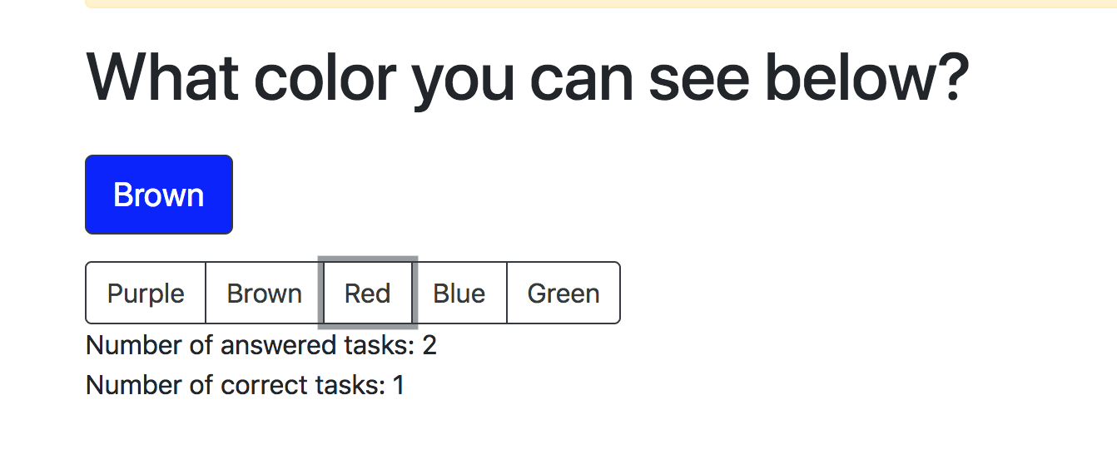
Stroop test: going deeper
https://github.com/chapkovski/stroop_test/tree/deeper

Slide 40
Stroop:deeper: models
class Player(BasePlayer): dump_tasks = models.LongStringField() num_answered = models.IntegerField(initial=0) num_correct = models.IntegerField(initial=0) from django.db import models as djmodels class Task(djmodels.Model): player = djmodels.ForeignKey(to=Player, related_name='tasks') color = models.StringField() text = models.StringField() answer = models.StringField(null=True)

Slide 41
Stroop:deeper: pages
import json class WorkPage(Page): timer_text = 'Time left to complete the task:' timeout_seconds = 10 def before_next_page(self): self.player.dump_tasks = json.dumps(list(self.player.tasks.all().values()))

Slide 42
Stroop:deeper: routing.connect
def connect(self, message, **kwargs): player = Player.objects.get(id=self.kwargs['player']) unanswered_tasks = player.tasks.filter(answer__isnull=True) if unanswered_tasks.exists(): task = unanswered_tasks.first() else: color, text = random.sample(Constants.colors, 2) task = player.tasks.create(color=color, text=text) response = self.prepare_task(player, task) self.send(response)

Slide 43
Stroop:deeper: routing.receive
def receive(self, text=None, bytes=None, **kwargs): player = Player.objects.get(id=self.kwargs['player']) oldtask = player.tasks.filter(answer__isnull=True).first() oldtask.answer = text oldtask.save() player.num_answered += 1 if text == oldtask.color: player.num_correct += 1 color, text = random.sample(Constants.colors, 2) newtask = player.tasks.create(color=color, text=text) response = self.prepare_task(player, newtask) player.save() self.send(response)

Slide 44
Stroop:deeper: routing.prepare_task
def prepare_task(self, player, task): return {'color_text': task.text, 'color_color': task.color, 'num_answered': player.num_answered, 'num_correct': player.num_correct, }

Slide 45
Stroop:deeper: template
HTML
<div>Number of answered tasks:
<span class="num_answered">{{ player.num_answered }}</span></div> <div>Number of correct tasks:
<span class="num_correct">{{ player.num_correct }}</span></div>
JavaScript
$('span.num_answered').html(obj.num_answered); $('span.num_correct').html(obj.num_correct);

Slide 46
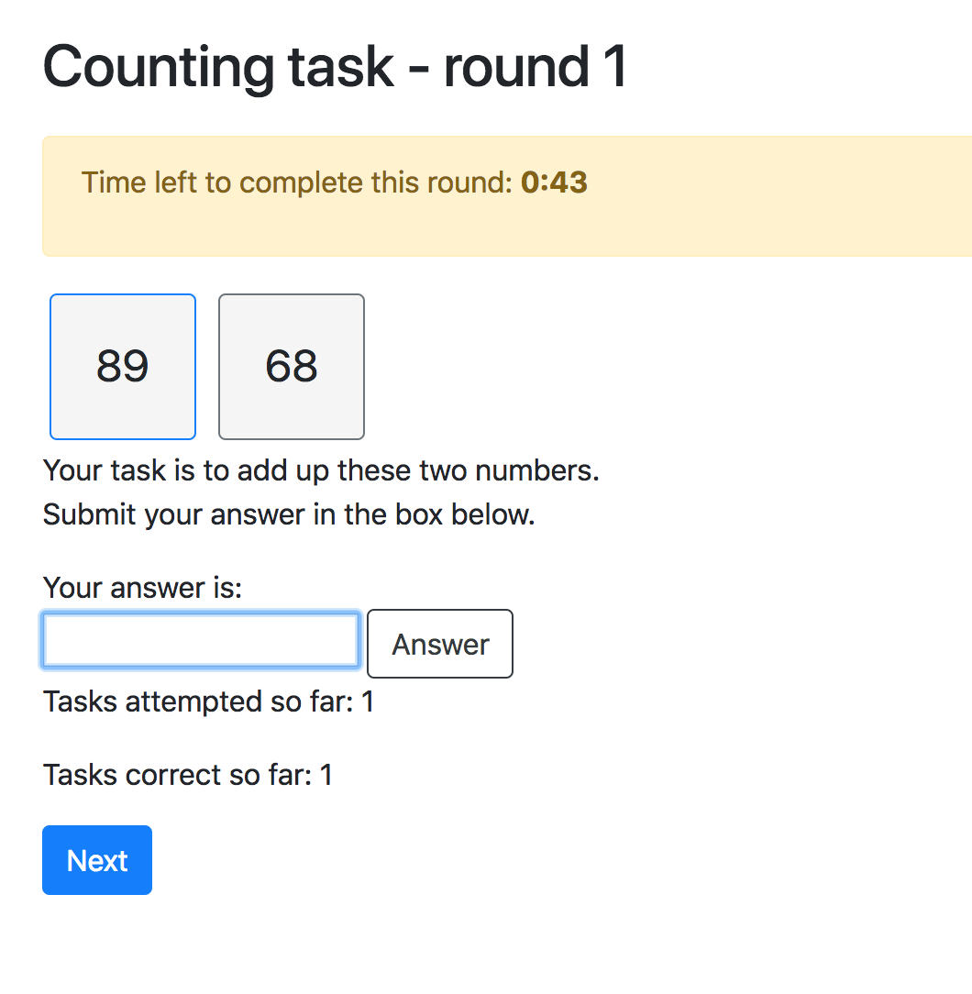
Our task: Real Effort Task
update the Public Good Game with Punishment so at the beginning people will earn their endowment, not just get it (in some treatments)

Slide 47
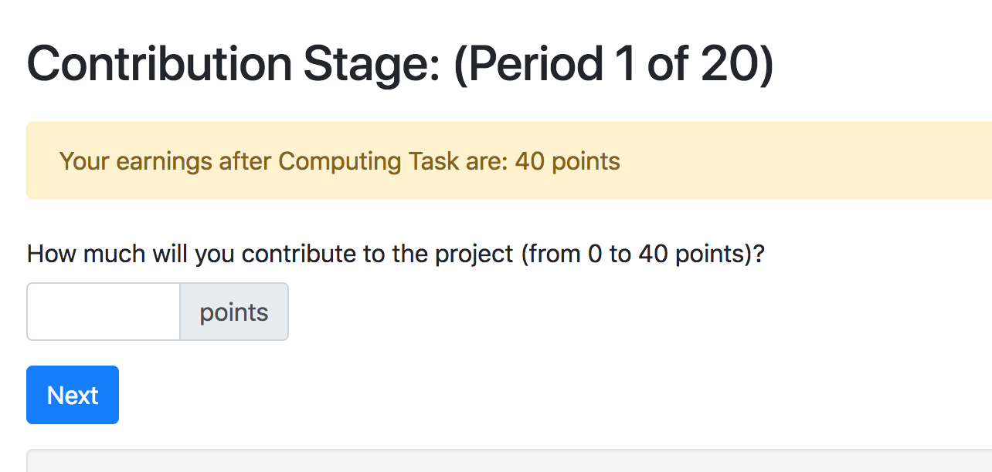
Our task: updated Contribution stage
update the Public Good Game with Punishment so at the beginning people will earn their endowment, not just get it (in some treatments)

Slide 48
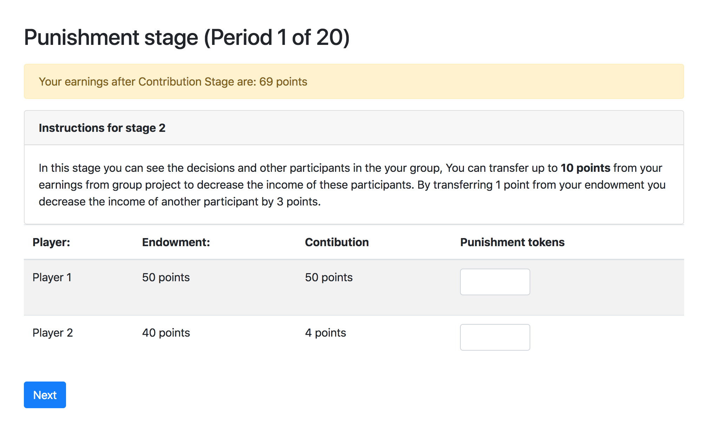
Our task: updated Punishment
update the Public Good Game with Punishment so at the beginning people will earn their endowment, not just get it (in some treatments)

Slide 49
Django Channels
Technology to send information in real time without submitting the page through WebSockets to/from Django database
routing.py
through websocket
models.py
consumers.py
Page (html)

Slide 50
Plan of work: html
Creating a real effort page:
In block content:
<div class="left "></div> <div class="right"></div> <input id="answer"> <button>Answer</button> <p> Tasks attempted so far: <span id="tasks_attempted">{{ player.finished_tasks.count }}</span></p> <p> Tasks correct so far: <span id="tasks_correct"> {{ player.num_tasks_correct }}</span></p>
{% block scripts %} {% include 'includes/js_work_page.html' %} {% endblock %}

Slide 51
Plan of work: html
Creating a real effort page:
In block content:
<div class="left "></div> <div class="right"></div> <input id="answer"> <button>Answer</button> <p> Tasks attempted so far: <span id="tasks_attempted">{{ player.finished_tasks.count }}</span></p> <p> Tasks correct so far: <span id="tasks_correct"> {{ player.num_tasks_correct }}</span></p>
{% block scripts %} {% include 'includes/js_work_page.html' %} {% endblock %}
Two empty divs for left
and right numbers

Slide 52
Plan of work: html
Creating a real effort page:
In block content:
<div class="left "></div> <div class="right"></div> <input id="answer"> <button>Answer</button> <p> Tasks attempted so far: <span id="tasks_attempted">{{ player.finished_tasks.count }}</span></p> <p> Tasks correct so far: <span id="tasks_correct"> {{ player.num_tasks_correct }}</span></p>
{% block scripts %} {% include 'includes/js_work_page.html' %} {% endblock %}
Input field for answer
and button

Slide 53
Plan of work: html
Creating a real effort page:
In block content:
<div class="left "></div> <div class="right"></div> <input id="answer"> <button>Answer</button> <p> Tasks attempted so far: <span id="tasks_attempted">{{ player.finished_tasks.count }}</span></p> <p> Tasks correct so far: <span id="tasks_correct"> {{ player.num_tasks_correct }}</span></p>
{% block scripts %} {% include 'includes/js_work_page.html' %} {% endblock %}
two divs to show their
progress so far

Slide 54
Plan of work: html
Creating a real effort page:
In block content:
<div class="left "></div> <div class="right"></div> <input id="answer"> <button>Answer</button> <p> Tasks attempted so far: <span id="tasks_attempted">{{ player.finished_tasks.count }}</span></p> <p> Tasks correct so far: <span id="tasks_correct"> {{ player.num_tasks_correct }}</span></p>
{% block scripts %} {% include 'includes/js_work_page.html' %} {% endblock %}
javascript code to
connect
the channels

Slide 55
Plan of work: javascript
<script> $(function () { var ws_scheme = window.location.protocol == "https:" ? "wss" : "ws"; var ws_path = ws_scheme + '://' + window.location.host + "/tasktracker/participant/{{ participant.code }}/player/{{ player.pk}}"; var socket = new ReconnectingWebSocket(ws_path); // Handle messages sent by the server. socket.onmessage = function (event) { var obj = jQuery.parseJSON(event.data); $('span#tasks_attempted').html(obj.tasks_attempted); $('span#tasks_correct').html(obj.tasks_correct); $('div.left').html(obj.left); $('div.right').html(obj.right); } $("button.answer").on("click", function () { var msg = { 'answer': $('input#answer').val(), }; if (socket.readyState === WebSocket.OPEN) { socket.send(JSON.stringify(msg)); } ; $("input#answer").val(''); }); }); </script>

Slide 56
Plan of work: javascript
$(function () { var ws_scheme = window.location.protocol == "https:" ? "wss" : "ws";
var ws_path = ws_scheme + '://' + window.location.host +
"/tasktracker/participant/{{ participant.code }}/player/{{ player.pk}}";
var socket = new ReconnectingWebSocket(ws_path); });
The path that helps Dj.Channels to understand
what to do with a created channel

Slide 57
Plan of work: javascript
$(function () { var ws_scheme = window.location.protocol == "https:" ? "wss" : "ws";
var ws_path = ws_scheme + '://' + window.location.host +
"/tasktracker/participant/{{ participant.code }}/player/{{ player.pk}}";
var socket = new ReconnectingWebSocket(ws_path); });
final path for the specific player looks like:
ws://tasktracker/participant/zbq5qrow/player/1

Slide 58
Plan of work: javascript
socket.onmessage = function (event) { var obj = jQuery.parseJSON(event.data); $('span#tasks_attempted').html(obj.tasks_attempted); $('span#tasks_correct').html(obj.tasks_correct); $('div.left').html(obj.left); $('div.right').html(obj.right); }
What should we do if there is incoming message from server

Slide 59
Plan of work: javascript
socket.onmessage = function (event) { var obj = jQuery.parseJSON(event.data); $('span#tasks_attempted').html(obj.tasks_attempted); $('span#tasks_correct').html(obj.tasks_correct); $('div.left').html(obj.left); $('div.right').html(obj.right); }
we get the data and convert it to javascript object

Slide 60
Plan of work: javascript
socket.onmessage = function (event) { var obj = jQuery.parseJSON(event.data); $('span#tasks_attempted').html(obj.tasks_attempted); $('span#tasks_correct').html(obj.tasks_correct);
$('div.left').html(obj.left); $('div.right').html(obj.right); }
we put the info from this data to empty divs
with player’s results

Slide 61
Plan of work: javascript
socket.onmessage = function (event) { var obj = jQuery.parseJSON(event.data); $('span#tasks_attempted').html(obj.tasks_attempted); $('span#tasks_correct').html(obj.tasks_correct); $('div.left').html(obj.left); $('div.right').html(obj.right); }
and we put new two random numbers to the left and right divs

Slide 62
Plan of work: javascript
$("button.answer").on("click", function () { var msg = { 'answer': $('input#answer').val(), }; if (socket.readyState === WebSocket.OPEN) { socket.send(JSON.stringify(msg)); } ; $("input#answer").val(''); });
when Answer button is clicked we send the answer
via socket in a form of a dictionary
{‘answer’: answer}

Slide 63
Creating oTree extensions:
add app to EXTENSIONS_APPS in Settings.py
create otree_extensions folder within an app folder
admin.py adds new records to ‘Data’
urls.py adds new urls overall
consumers.py and routing.py are responsible for django channels

Slide 64
consumers.py
class TaskTracker(WebsocketConsumer): url_pattern = ( r'^/tasktracker' + '/participant/(?P<participant_code>[a-zA-Z0-9_-]+)' + '/player/(?P<player>[0-9]+)' + '$') def clean_kwargs(self, kwargs): … def create_task(self, player): … def get_task(self): … def receive(self, text=None, bytes=None, **kwargs): … def connect(self, message, **kwargs): self.clean_kwargs(kwargs) self.send(self.get_task()) def send(self, content): self.message.reply_channel.send({'text': json.dumps(content)})

Slide 65
consumers.py
class TaskTracker(WebsocketConsumer): url_pattern = ( r'^/tasktracker' + '/participant/(?P<participant_code>[a-zA-Z0-9_-]+)' + '/player/(?P<player>[0-9]+)' + '$') def clean_kwargs(self, kwargs): … def create_task(self, player): … def get_task(self): … def receive(self, text=None, bytes=None, **kwargs): … def connect(self, message, **kwargs): self.clean_kwargs(kwargs) self.send(self.get_task()) def send(self, content): self.message.reply_channel.send({'text': json.dumps(content)})
That is the path that
we used in Javascript

Slide 66
consumers.py
class TaskTracker(WebsocketConsumer): url_pattern = ( r'^/tasktracker' + '/participant/(?P<participant_code>[a-zA-Z0-9_-]+)' + '/player/(?P<player>[0-9]+)' + '$') def clean_kwargs(self, kwargs): … def create_task(self, player): … def get_task(self): … def receive(self, text=None, bytes=None, **kwargs): … def connect(self, message, **kwargs): self.clean_kwargs(kwargs) self.send(self.get_task()) def send(self, content): self.message.reply_channel.send({'text': json.dumps(content)})
This code runs when
a client connects to a
channel (when page is
loaded)

Slide 67
consumers.py
class TaskTracker(WebsocketConsumer): url_pattern = ( r'^/tasktracker' + '/participant/(?P<participant_code>[a-zA-Z0-9_-]+)' + '/player/(?P<player>[0-9]+)' + '$') def clean_kwargs(self, kwargs): … def create_task(self, player): … def get_task(self): … def receive(self, text=None, bytes=None, **kwargs): … def connect(self, message, **kwargs): self.clean_kwargs(kwargs) self.send(self.get_task()) def send(self, content): self.message.reply_channel.send({'text': json.dumps(content)})
This code runs when we get a message from a
client (when s/he hits an
‘answer’ button)

Slide 68
consumers.py
class TaskTracker(WebsocketConsumer): url_pattern = ( r'^/tasktracker' + '/participant/(?P<participant_code>[a-zA-Z0-9_-]+)' + '/player/(?P<player>[0-9]+)' + '$') def clean_kwargs(self, kwargs): … def create_task(self, player): … def get_task(self): … def receive(self, text=None, bytes=None, **kwargs): … def connect(self, message, **kwargs): self.clean_kwargs(kwargs) self.send(self.get_task()) def send(self, content): self.message.reply_channel.send({'text': json.dumps(content)})
This one sends something
back to client’s page

Slide 69
consumers.py
class TaskTracker(WebsocketConsumer): url_pattern = ( r'^/tasktracker' + '/participant/(?P<participant_code>[a-zA-Z0-9_-]+)' + '/player/(?P<player>[0-9]+)' + '$') def clean_kwargs(self, kwargs): … def create_task(self, player): … def get_task(self): … def receive(self, text=None, bytes=None, **kwargs): … def connect(self, message, **kwargs): self.clean_kwargs(kwargs) self.send(self.get_task()) def send(self, content): self.message.reply_channel.send({'text': json.dumps(content)})
here we get the task if
it exists or create a new
one if it doesn’t

Slide 70
consumers.py
class TaskTracker(WebsocketConsumer): url_pattern = ( r'^/tasktracker' + '/participant/(?P<participant_code>[a-zA-Z0-9_-]+)' + '/player/(?P<player>[0-9]+)' + '$') def clean_kwargs(self, kwargs): … def create_task(self, player): … def get_task(self): … def receive(self, text=None, bytes=None, **kwargs): … def connect(self, message, **kwargs): self.clean_kwargs(kwargs) self.send(self.get_task()) def send(self, content): self.message.reply_channel.send({'text': json.dumps(content)})
Here the new task
is created

Slide 71
routing.py
from channels.routing import route, route_class from .consumers import TaskTracker channel_routing = [ route_class(TaskTracker, path=TaskTracker.url_pattern), ]
Simply adding our new
TaskTracker to routing

Slide 72
models.py
class Task(djmodels.Model): player = djmodels.ForeignKey(to=Player, related_name='tasks') correct_answer = models.IntegerField() answer = models.IntegerField(null=True) left = models.IntegerField() right = models.IntegerField() def get_dict(self): return { "left": self.left, "right": self.right, "correct_answer": self.correct_answer, }

Slide 73
models.py
class Task(djmodels.Model): player = djmodels.ForeignKey(to=Player, related_name='tasks') correct_answer = models.IntegerField() answer = models.IntegerField(null=True) left = models.IntegerField() right = models.IntegerField() def get_dict(self): return { "left": self.left, "right": self.right, "correct_answer": self.correct_answer, }
it’s just for convenience.
now we can get the tasks
by typing:
player.tasks.all()

Slide 74
models.py
class Task(djmodels.Model): player = djmodels.ForeignKey(to=Player, related_name='tasks') correct_answer = models.IntegerField() answer = models.IntegerField(null=True) left = models.IntegerField() right = models.IntegerField() def get_dict(self): return { "left": self.left, "right": self.right, "correct_answer": self.correct_answer, }
when we create new task
the answer is empty

Slide 75
models.py
class Task(djmodels.Model): player = djmodels.ForeignKey(to=Player, related_name='tasks') correct_answer = models.IntegerField() answer = models.IntegerField(null=True) left = models.IntegerField() right = models.IntegerField() def get_dict(self): return { "left": self.left, "right": self.right, "correct_answer": self.correct_answer, }
we call this method to get dictionary that we send back to page

Slide 76
models.py
class Player(BasePlayer): def get_unfinished_task(self): … def finished_tasks(self): … def get_correct_tasks(self): … def num_tasks_correct(self): … def dump_tasks(self): …
This one returns the
unfinished task if there is
any. Or False

Slide 77
models.py
class Player(BasePlayer): def get_unfinished_task(self): … def finished_tasks(self): … def get_correct_tasks(self): … def num_tasks_correct(self): … def dump_tasks(self): …
This method dumps all
tasks into json, and
write them into a player’s field

Slide 78
consumers.py: get_task, create_task
def create_task(self, player): left, right = random.sample(Constants.rchoices, 2) correct_answer = left + right task = player.tasks.create(left=left, right=right, correct_answer=correct_answer) return task.get_dict()

Slide 79
consumers.py: get_task, create_task
def get_task(self): player = self.get_player() unfinished_task = player.get_unfinished_task() task = unfinished_task.get_dict() if unfinished_task else self.create_task(player) task.update({ 'tasks_attempted': player.finished_tasks.count(), 'tasks_correct': player.num_tasks_correct, }) return task

